Slide 1
MGMT 58600: Python Programming
Lecture 9
Dr. Shoaib Khan

Slide 2
Pandas
Pandas is a Python library used for data manipulation and analysis. It provides a convenient way to analyze and clean data.
Pandas is extensively used for:
Data Cleaning
Data Transformation
Data Analysis
Machine Learning
Data Visualization
The Pandas library introduces two new data structures to Python - Series and DataFrame, both of which are built on top of NumPy.

Slide 3
Why Use Pandas?
Handle Large Data Efficiently:
Pandas is designed for handling large datasets. It provides powerful tools that simplify tasks like data filtering, transforming, and merging.
It also provides built-in functions to work with formats like CSV, JSON, TXT, Excel, and SQL databases.
Tabular Data Representation:
Pandas DataFrames handle data in tabular format. This allows easy indexing, selecting, replacing, and slicing of data.
Data Cleaning and Preprocessing:
Data cleaning and preprocessing are essential steps in the data analysis pipeline, and Pandas provides powerful tools to facilitate these tasks.
It has methods for handling missing values, removing duplicates, handling outliers, data normalization, etc.
Time Series Functionality:
Pandas contains an extensive set of tools for working with dates, times, and time-indexed data as it was initially developed for financial modeling.
Free and Open-Source
Pandas follows the same principles as Python, allowing you to use and distribute Pandas for free, even for commercial use.

Slide 4
Getting Started With Pandas
Pandas can be installed by running the following command:
pip install pandas
We can import Pandas in Python using the import statement:
import pandas as pd
A Pandas Series is like a column in a table. It consists of two main components: the labels and the data.
0 'John'
1 30
2 6.2
3 False
dtype: object
The labels are the index values assigned to each data point, while the data represents the actual values stored in the Series.

Slide 5
Series
There are multiple ways to create a Pandas Series, but the most common way is by using a Python list.
import pandas as pd a = [1, 7, 5] myvar = pd.Series(a) print(myvar)
The labels in the Pandas Series are index numbers by default.
print(myvar[2])
We can also specify labels while creating the series using the index argument in the Series() method.
myvar = pd.Series(a, index = ["x", "y", "z"]) print(myvar)
To access the series elements, we use the specified labels instead of the default index number
print(myvar["y"])

Slide 6
Series
You can also use a key/value object, like a dictionary, when creating a Series.
import pandas as pd calories = {"day1": 420, "day2": 380, "day3": 390} myvar = pd.Series(calories) print(myvar)
To select only some of the items in the dictionary, use the index argument and specify only the items you want to include in the Series.
myvar = pd.Series(calories, index = ["day1", "day2"]) print(myvar)

Slide 7
DataFrame
A DataFrame is like a table where the data is organized in rows and columns.
It is a two-dimensional data structure like a two-dimensional array.
Country Capital Population
0 Canada Ottawa 37742154
1 Australia Canberra 25499884
2 UK London 67886011
3 Brazil Brasília 212559417
Here:
Country, Capital and Population are the column names.
Each row represents a record, with the index value on the left. The index values are auto-assigned starting from 0.
Each column contains data of the same type. For instance, Country and Capital contain strings, and Population contains integers.
The DataFrame is similar to a table in a SQL database, or a spreadsheet in Excel.

Slide 8
Creating DataFrames
We can create a Pandas DataFrame in the following ways:
Using Python Dictionary
data = {"calories": [420, 380, 390], "duration": [50, 40, 45]} myvar = pd.DataFrame(data)
Using Python List
data = [['John', 25, 'New York’], ['Alice', 30, 'London’], ['Bob', 35, 'Paris’]]
df = pd.DataFrame(data, columns=['Name', 'Age', 'City'])
From a File
df = pd.read_csv('data.csv’)
Creating an empty dataframe
df = pd.DataFrame()

Slide 9
Viewing the Data
The head() method returns the headers and a specified number of rows, starting from the top.
df = pd.read_csv('data.csv') print(df.head(10))
The tail() method returns the headers and a specified number of rows, starting from the bottom.
df = pd.read_csv('data.csv') print(df.tail(10))
The info() method gives you more information about the data set.
df = pd.read_csv('data.csv') print(df.info())

Slide 10
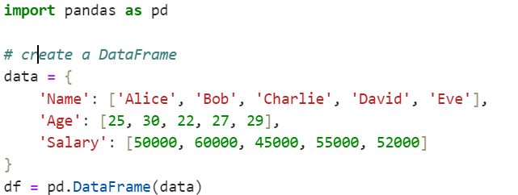


Pandas DataFrames: Selecting Data
In Pandas, we can use square brackets and their labels or positions to select the data we want.

Slide 11
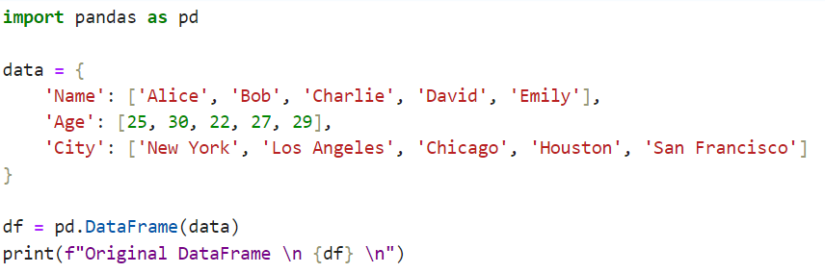



Using loc and iloc to Select Data
The loc and iloc methods in Pandas are used to access data by using label or integer index.
loc selects rows and columns with specific labels
iloc selects rows and columns at specific index number

Slide 12


Here,
Using df.loc[1:3, ['Name', 'Age']] - selects rows 1 to 3 and columns Name and Age from df
Using df.iloc[1:4, [0, 2]] - selects rows 1 to 3 and columns at index positions 0 and 2 from df

Slide 13
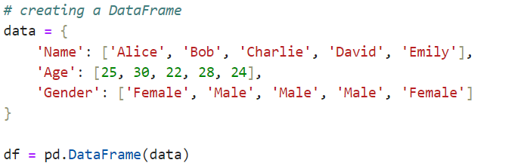

Select Rows Based on Specific Criteria
In Pandas, we can use boolean conditions to filter rows based on specific criteria. For example,

Slide 14

Select Rows Based on Specific Criteria
In this example, we have selected the rows where the age is greater than 25.
The boolean indexing is done using the condition df[‘Age’]> 25
This creates a boolean mask. And when this mask is applied to the DataFrame, it selects only the rows where the condition is True.
query() to Select Data: The query() method in Pandas allows you to select data using a more SQL-like syntax.

Slide 15
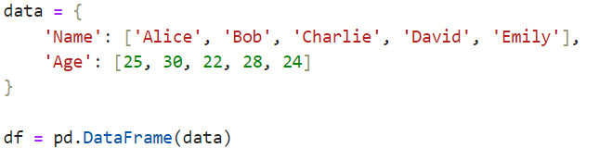


Select Rows Based on a List of Values
Pandas provides us with the method named isin() to filter rows based on a list of values. For example,

Slide 16
Select Rows Based on a List of Values
In this example, we want to select only the rows where the name is either Bob or David.
We created a list names_to_filter with the names we want to filter by and then used the isin() method to filter the rows based on the values in the Name column.

Slide 17
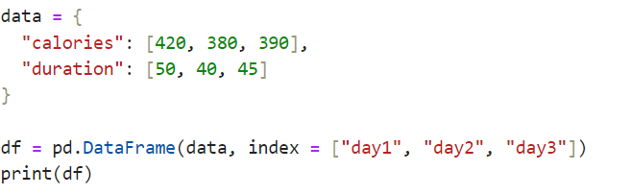

Named Indexes
With the index argument, you can name your own indexes.
Use the named index in the loc attribute to return the specified row(s).

